Slide 1


Automated Rapid Response in Critical Condition
Muhammad Usman Sheikh, Hammad Kabir and Hanan Al-Tous
Department of Communications and Networking
2019

Slide 2
ICT Industry and Customer’s Point of View
Telecom Industry Point of View
End User’s Point of View
Researcher

Slide 3
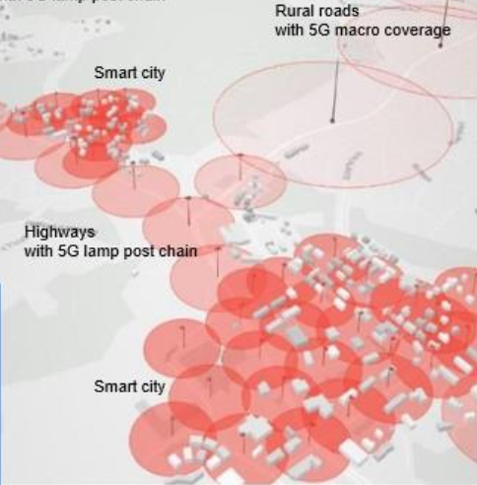
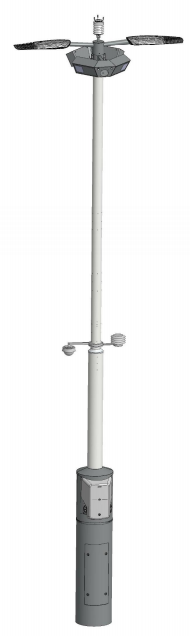
Enabling Technology
Ultra Dense Network (UDN) deployment with the help of Smart 5G light pole.
Smart pole is equipped with cameras and numerous sensors which makes an eco system of Internet of Things (IoTs) .
Smart 5G
light pole

Slide 4
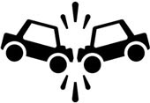
Motivation
Approximately 1.35 million people die each year as a result of road traffic crashes.
Road traffic injuries are the leading cause of death for children and young adults aged 5-29 years, and that is due to inadequate post-crash reporting and response time
*World Health Report 2018
Notes:
Steenbruggen, J., Kusters, M., and Broekhuizen, G. Best practice in european traﬃc incident management. Procedia-Social and Behavioral Sciences 48 (2012), 297–310.

Slide 5

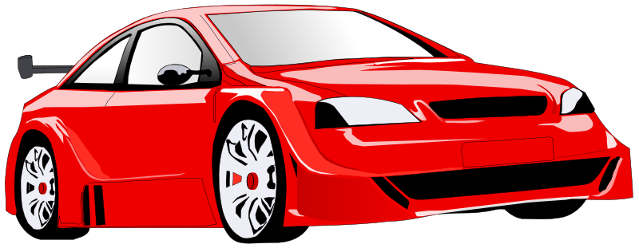
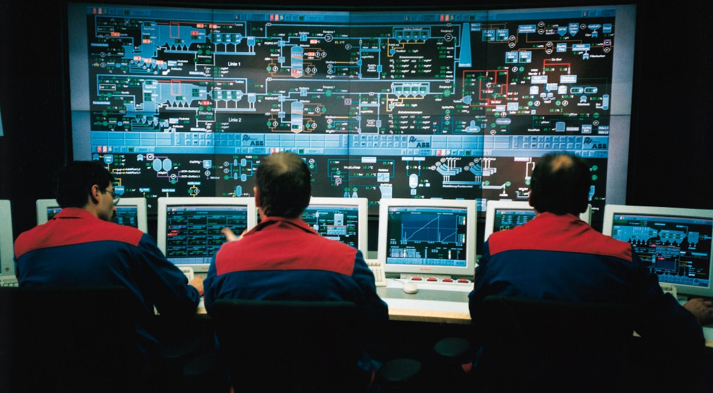

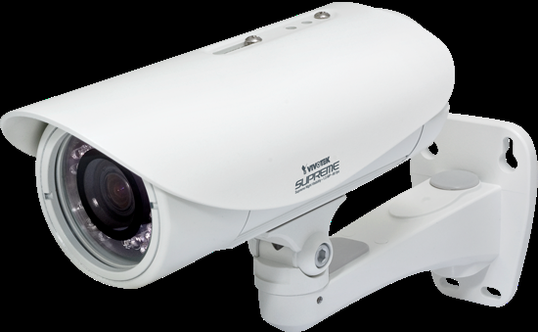
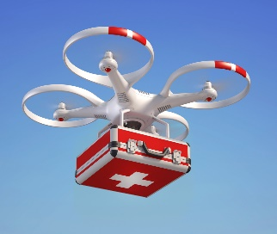
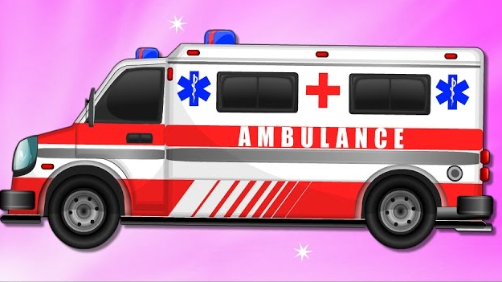

Flow Chart of Rapid Response System
Collision detection (accident) Smart car
Cars are equipped with collision detectors/sim card/GPS
Message sent with GPS information to Control Unit / Message sent to other cars
Car make use of cellular service provided by smart pole to send message to control unit and to other cars.
Control Unit respond to the Car with ACK
Radio interface of cellular network
Person at control Unit analyzes the situation by accessing camera on the nearest smart pole.
Smart pole can stream a high definition video and again that requires high data, with low latency
Surveillance command is send to Drone
Drone is controlled with mobile service/ high definition video
Incident information is shared with Ambulance for rescue operation
Remote support by doctors from hospital/ remote health services
Notes:
Human delay in doing a call
Or people taking photos,
Or in night no one to send the call for help
You are not able to inform other cars
Two stages for action
From light pole using on street camera for video or pictures
Control unit using ML and Signal processing determine situation of of the accident and road
Drone can be sent fro emergency help or for taking videos
Ambulance and police will be informed directly with the location of the accidents, and car information
Inform health insurance, car maintenance of the incidents and provide phots immediately

Slide 6
Thanks

